Slide 1

My dream job– programmer
20904 김민서

Slide 2

Contents
Who is programmers?
How many types of programmers?
What can they use?
The advantages of coding
What I want to say

Slide 3
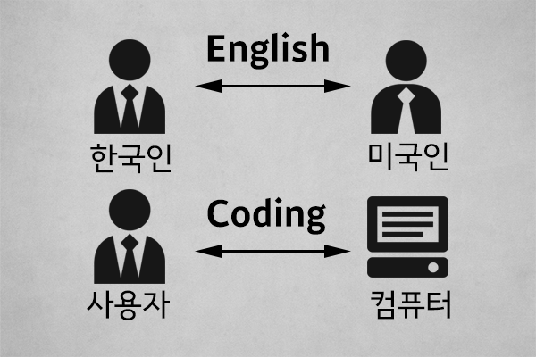


Who is programmer?

Slide 4







How many types of programmers?

Slide 5


























What languages can programmers use?

Slide 6


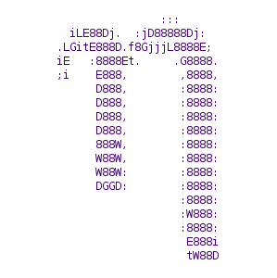







What can they use?

Slide 7
the advantages of coding
Lots of things you can try
Help to think logically
Make things easier with computers
Create what you imagine

Slide 8
What i want to say is ……
How about trying coding?
It could be interesting for you!!!

Slide 9
https://github.com/ggace?tab=repositories

Slide 10

Thanks

